Slide 1

Research and Innovation: Iteration 2
Baian Khanjar, Andy Lin, Celeste Menard, Sohal Patel, Ruomei Wang, Emily Wantland
Added Value Group

Slide 2
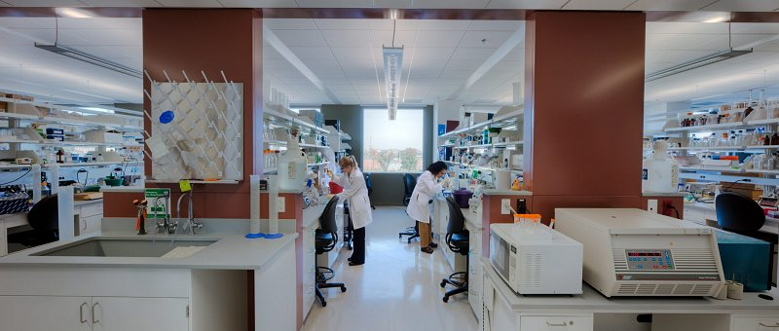
What We’ll Cover...
Business Needs
Streamlining the application process
Connecting researchers to funding
Connecting industry partners to research opportunities
Cost and Benefits
Project Operation and Development Costs
Each project will bring in upwards of 40% of the overall cost

Slide 3
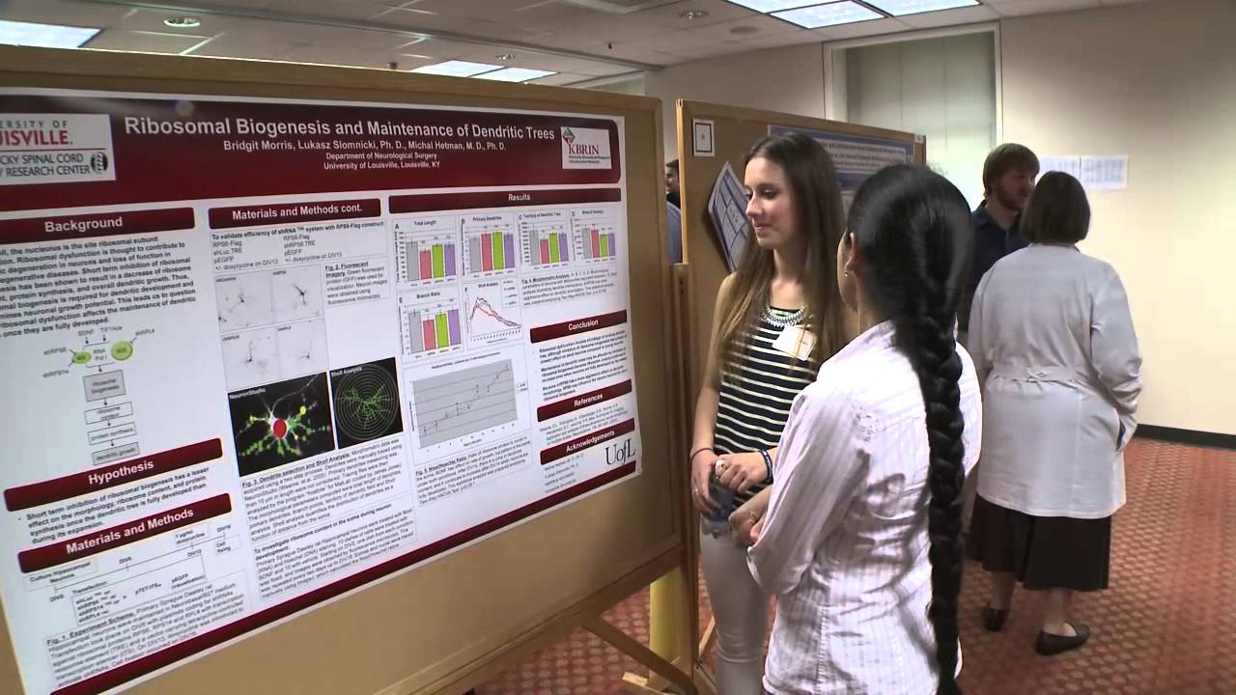
Funding Constraints
Problems with funding right now:
The website is constraining the ability to make money
The inability to effectively navigate the website makes it difficult to connect industry partners to funding opportunities

Slide 4

Website Navigation
When navigating the website, it was difficult to find the research application page.
For students it takes 2 clicks
For researchers it takes 4 clicks
For industry partners it takes 5 clicks and brings you to a new website that you also need to navigate

Slide 5
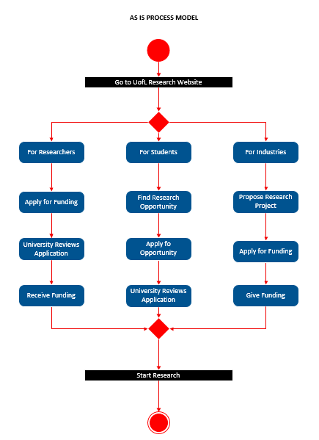
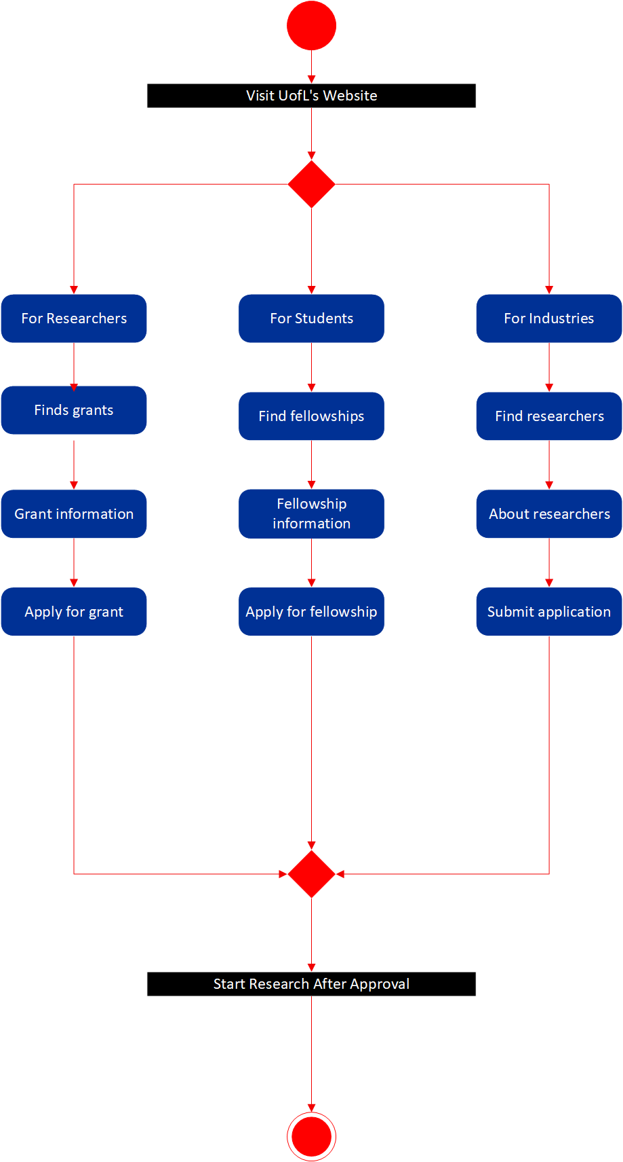
As-Is Process Model
To-Be Process Model
Notes:
These are our As-Is and To-be Process models, as you can see they are visually similar. However, small changes differentiate them.

Slide 6
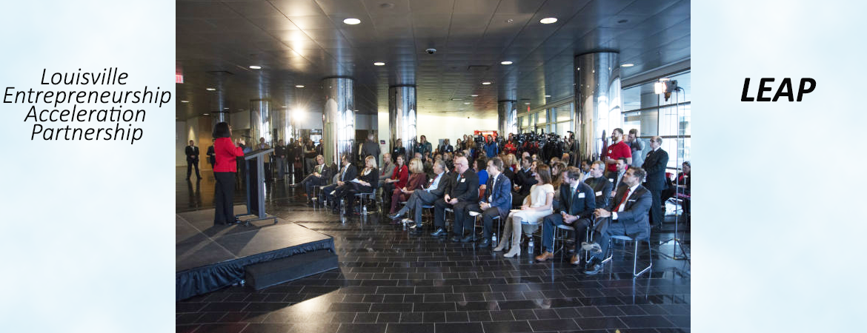
Public Engagement
The university highlights completed research projects via newsletter, many can’t find it
Achievements are difficult to find
Measures of excellence are not highlighted
The newsletter needs improvement

Slide 7
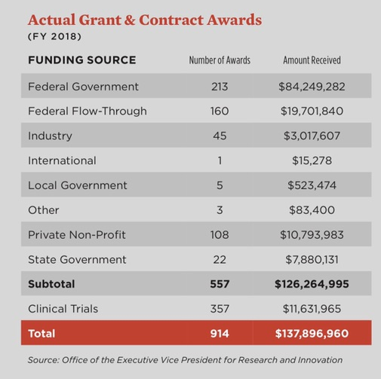
Revenue After Changes
Average Grant: 15,000,000
Revenue from 40% of 10 grants: $600,000
Revenue from 40% of 2 grants: $120,000
Revenue from 40% of 5 grants: $300,000
Notes:
These numbers can be found in Appendix A

Slide 8

Project Costs
Our Cost
1 Year
Operating: $144,200
Development: $400
5 Years (2% Inflation Rate)
Operating: $146,300
Development: $2,500
Notes:
The 5 Year also includes the development year. The development costs include WordPress, Amazon Cloud S3 Storage, and Amazon DynamoDB which is a no SQL database.

Slide 9
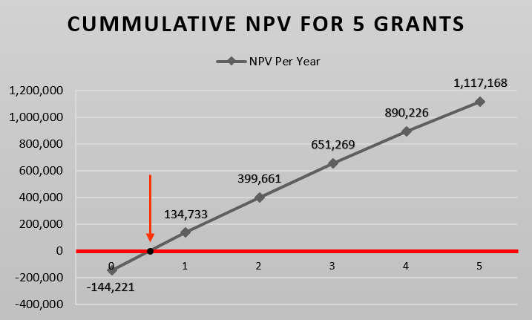
ROI: 766% NPV: $1,117,168.00
Notes:
We will breakeven before year 1 ends, so there is a relatively quick return on investment.

Slide 10

Prototypes
Prototype 1
Prototype 2
Prototype 3

Slide 11
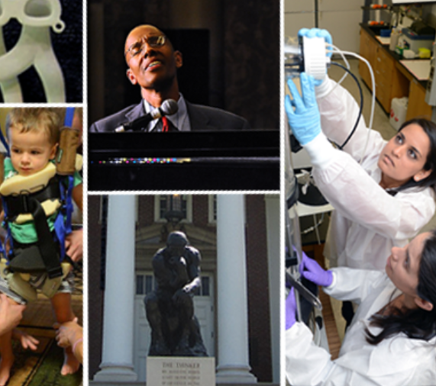
Summary
Process Problems
Funding Constraints
Website Navigation
Public Engagement
Quick Numbers
ROI: 766%
NPV: $1,117,168
Notes:
When factoring in 5 additional grants of which the university receives 40% as revenue, our five year projection will yield a 766% return on investment. Our net present value will be $1,117,168.

Slide 12
Questions?

